Slide 1
Ethical issues in evidence-based practice and the use of technology
Socw 524 week 2
Dr. Castro-Guillen

Slide 2
Class overview
Welcome and Announcements
  Class on 1/22/26 in person
  EBP Paper Part I due 1/24/26
Article Presentations -
Today’s topic – Ethical Issues in Evidenced-based Practice and the Use of Technology
In-class learning activities
  PICOT Practice with a case study
  PICOT Question Template
Next Class

Slide 3
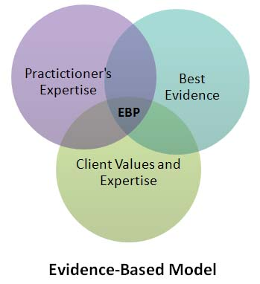
REVIEW
3

Slide 4

six-Step Process
1. Research Practice Question
2. Locate Relevant Research Knowledge
3. Critically Appraise the Knowledge
4. Discuss what you find with the client
5.Develop an Intervention Plan
6. Implement and Evaluate.
This is what we aim for in SW Practice.

Slide 5
Ethics and values in evidenced-based practice

Slide 6
Important Concepts – simple internet search
Ethics – moral principles that govern a person’s behavior or the conducting of an activity
Morals – beliefs about what is right and wrong; principles that people live by
Values – beliefs about what is important

Slide 7
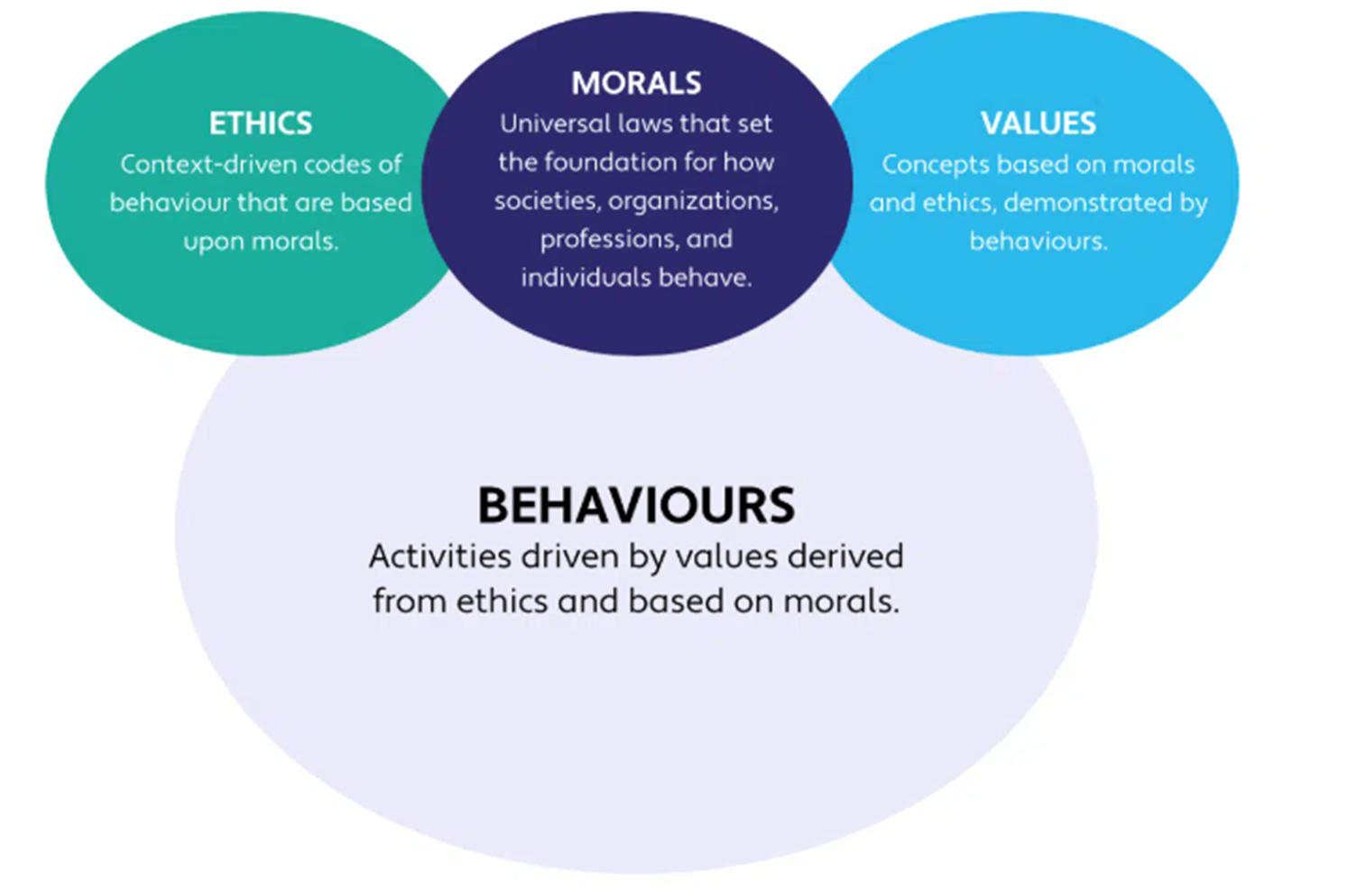
https://healthcaresalute-soinsdesantesalute.com/items/what-are-morals/

Slide 8
Quote
H.J. Aponte (1994), p. 170
“Values frame the entire process of therapy. Values are the social standards by which therapists define reality, identify problems, formalize evaluations, select interventions, and determine therapeutic goals. All transactions between therapists and clients involve negotiations about the respective value systems that each party brings into the therapeutic process.”

Slide 9
Ethical issues in evidence-based practice
Evidence for EBP Interventions
Evidence against EB Interventions
Promotes effectiveness, efficiency, and accountability
History shows that social workers have seldom applied EBP in their practice
Research findings should guide the selection and application of interventions in practice
Social workers should remain current with new EBP
Enhances credibility of the profession
Helps to bridge the gap between research and practice
Lack of relevance to “real practice” in “real world”
Promotes “cookbook” approach to practice
Lack of cultural humility and sensitivity
Neglects other factors that influence outcomes (e.g., therapeutic relationship)
Cost of training and sustainability
Increases workload for social workers without increasing salary
Developers of EBPs may not be practitioners

Slide 10
Ethical and diversity considerations to consider with Evidence-based practice
Furman Article (2009)
  Privileging knowledge over values
  Privileging some types of knowledge over others
  Privileging that which is measurable
  Privileging developing methods over social workers (e.g., helping relationship)

Slide 11
In-class Discussion Activity:
How does Evidence-Based Practice (the process) align or not align with the Core Values of Social Work?
  Service
  Social Justice
  Dignity and worth of the person
  Importance of human relationships
  Integrity
  Competence
What about Evidence-Based Interventions (the treatment)?

Slide 12
Five Step e-t-h-i-c model of decision making
(E. Congress, 1999)
Examine relevant values
Think about relevant laws, policies, regulations, and code provisions
Hypothesize about different consequences
Identify who will be helped and harmed in terms of the most vulnerable
Consult with supervisors and other colleagues.

Slide 13
By: Karen Allen, Ph.D., LMSW
What Is an Ethical Dilemma? in The New Social Worker® online magazine

Slide 14
What would you do?
Eye on Ethics
Making Difficult Decisions
By Frederic G. Reamer, PhD
Social Work Today
October 14, 2002
Recently, I received a phone call from a seasoned social worker seeking consultation. The social worker is employed by a community mental health center where she provides clinical services to people with chronic mental illness. Two days earlier, one of her clients, Alice M., committed suicide. According to the social worker, Alice struggled for many years with depression and cocaine addiction.
Immediately following the suicide, Alice’s parents—who had participated in her treatment at various times in the context of family counseling—contacted the social worker to discuss this tragic turn of events. The social worker met with her parents, with whom she had considerable rapport, and they talked about Alice’s lifelong triumphs and challenges. Alice’s parents spoke at length about how much they appreciated the social worker’s earnest efforts to help their daughter. The parents also talked about how difficult it would be for them to bury their daughter the following day.
Toward the end of the conversation, Alice’s parents told the social worker that they wanted to ask a special favor. They explained that the social worker was an important person in their family’s life and that it would mean a lot to them if the social worker would deliver a eulogy at their daughter’s funeral.

Slide 15

Another Quote
“A boundary is the edge of appropriate behavior at a given moment in the relationship between a patient and therapist, as governed by the therapeutic context and contract. It may be defined by the physical, psychological, and/or social space occupied by the patient in the clinical relationship. Where the boundary line actually falls, or is perceived to fall, depends on the type and stage of therapy and may be subject to judgment and interpretation. Therapeutic boundaries are not hard-and-fast. Rather, they are movable and context-dependent, and their placement depends on a number of factors in the clinical situation. Both the flexibility of therapeutic boundaries and the limits of that flexibility can be understood by exploring the nature and significance of boundary crossings, as distinct from boundary violations (Glass, 2003; Gutheil & Gabbard, 1993, 1998).”

Slide 16
Nasw code of ethics, updated 2021, serves six purposes
1. The Code identifies core values on which social work’s mission is based.
2. The Code summarizes broad ethical principles that reflect the profession’s core values and establishes a set of specific ethical standards that should be used to guide social work practice.
3. The Code is designed to help social worker’s identify relevant considerations when professional obligations conflict or ethical uncertainties arise.

Slide 17
Nasw code of ethics, updated 2021, serves six purposes (cont.)
4. The Code provides ethical standards to which the general public can hold the social work profession accountable.
5. The Code socializes practitioners new to the field to social work’s mission, values, ethical principles, and ethical standards, and encourages all social workers to engage in self-care, ongoing education, and other activities to ensure their commitment to those same core features of the profession.
6. The Code articulates standards that the social work profession itself can use to assess whether social workers have engaged in unethical conduct. NASW has formal procedures to adjudicate ethics complaints filed against its members. In subscribing to this Code, social workers are required to cooperate in its implementation, participate in NASW adjudication proceedings, and abide by any NASW disciplinary rulings or sanctions based on it.

Slide 18
Preamble
The primary mission of the social work profession is to enhance human well-being and help meet the basic human needs of all people, with particular attention to the needs and empowerment of people who are vulnerable, oppressed, and living in poverty. A historic and defining feature of social work is the profession’s dual focus on individual well-being in a social context and the well-being of society. Fundamental to social work is attention to the environmental forces that create, contribute to, and address problems in living.
Social workers promote social justice and social change with and on behalf of clients. “Clients” is used inclusively to refer to individuals, families, groups, organizations, and communities. Social workers are sensitive to cultural and ethnic diversity and strive to end discrimination, oppression, poverty, and other forms of social injustice. These activities may be in the form of direct practice, community organizing, supervision, consultation, administration, advocacy, social and political action, policy development and implementation, education, and research and evaluation. Social workers seek to enhance the capacity of people to address their own needs. Social workers also seek to promote the responsiveness of organizations, communities, and other social institutions to individuals’ needs and social problems.
The mission of the social work profession is rooted in a set of core values. These core values, embraced by social workers throughout the profession’s history, are the foundation of social work’s unique purpose and perspective:

Slide 19
Nasw core values and ethical principles
Value: Service
Ethical Principle: Social workers’ primary goal is to help people in need and to address social problems.
Value: Social Justice
  Ethical Principle: Social workers challenge social injustice.
Value: Dignity and Worth of the Person
  Ethical Principle: Social workers respect the inherent dignity and worth of the person.

Slide 20
Nasw core values and ethical principles (CONT.)
Value: Importance of Human Relationships
  Ethical Principle: Social workers recognize the central importance of human relationships.
Value: Integrity
  Ethical Principle: Social workers behave in a trustworthy manner.
Value: Competence
  Ethical Principle: Social workers practice within their areas of competence and develop and enhance their professional expertise.

Slide 21
Nasw ethical standards
Social Workers’ ethical responsibilities to clients.
Social Workers’ ethical responsibilities to colleagues.
Social Workers’ ethical responsibilities in practice settings.
Social Workers’ ethical responsibilities as professionals.
Social Workers’ ethical responsibilities to the social work profession.
Social Workers’ ethical responsibilities to the broader society.

Slide 22
Ethical Responsibilities to Clients
Commitment to clients
Self-determination
Informed consent
Competence
Cultural competence
Conflicts of interest
Privacy and confidentiality
Access to records
9. Sexual relationships
10. Physical contact
11. Sexual harassment
12. Derogatory language
13. Payment for services
14. Clients who lack decision-making capacity
15. Interruption of services
16. Referral for services
17. Termination of services

Slide 23
Ethical responsibilities to colleagues
6. Sexual Relationships
7. Sexual Harassment
8. Impairment of Colleagues
9. Incompetence of Colleagues
10. Unethical Conduct of Colleagues
Respect
Confidentiality
Interdisciplinary Collaboration
Disputes Involving Colleagues
Consultation

Slide 24
Ethical responsibilities in practice settings
Supervision and Consultation
Education and Training
Performance Evaluation
Client Records
Billing
6. Client Transfer
7. Administration
8. Continuing Education and Staff Development
9. Commitments to Employers
10.Labor-Management Disputes

Slide 25
Ethical responsibilities as professionals
Competence
Discrimination
Private Conduct
Dishonesty, Fraud, and Deception
5. Impairment
6. Misrepresentation
7. Solicitations
8. Acknowledging Credit

Slide 26
Ethical responsibilities to the social work profession
Integrity of the Profession
Evaluation and Research

Slide 27
Ethical responsibilities to the broader society
1. Social Welfare
2. Public Participation
3. Public Emergencies
4. Social and Political Action

Slide 28
Video – John Rawls and the Veil of ignorance
Who? Political philosopher – how to create a fair and just society.
  https://www.youtube.com/watch?v=GuY79IKLO5U

Slide 29
Technology and social work practice

Slide 30
NASW Standards for technology in social work practice (2017)
“NASW partnered with ASWB, CSWE, and CSWA to develop a uniform set of technology standards for professional social workers to use as a guide in their practice.” (from Foreword, page 6)
“Social workers’ use of technology is proliferating. Technology has transformed the nature of social work practice and greatly expanded social workers’ ability to assist people in need. Contemporary social workers can provide services to individual clients by using online counseling, telephone counseling, videoconferencing, self-guided Web-based interventions, electronic social networks, mobile apps, automated tutorials, email, text messages, and a host of other services. Social workers’ use of technology has created new ways to interact and communicate with clients, raising fundamentally new questions about the meaning of the social worker-client relationship.” (from Introduction, page 7)
https://www.socialworkers.org/Practice/NASW-Practice-Standards-Guidelines/Standards-for-Technology-in-Social-Work-Practice

Slide 31
Standards divided into four main sections
Social workers’ use of technology to –
  Provide information to the public
  Design and deliver services
  Gather, manage, store, and access information about clients
  Educate and supervise social workers
https://www.socialworkers.org/Practice/NASW-Practice-Standards-Guidelines/Standards-for-Technology-in-Social-Work-Practice

Slide 32

https://www.youtube.com/watch?v=iuASVYZLigo

Slide 33
Picot practice

Slide 34
PICOT Application using case study
In-class activity
Read the case study on the next slide and complete the following:
1. Apply the PICOT Framework (use the acronym)?
2. What is your clinical question and concern (using the PICOT Framework)?
3. What keywords would you use for your literature search?
4. Identify the ethical issues in your case study.

Slide 35
CASE STUDY DETAILS – Danny
Danny is a 32-year-old Army veteran who comes to you reporting that he has been having unusual experiences, such as hearing the pigeons that live around his building talk to him. Additionally, he has been increasingly concerned that he is being monitored by government agencies. In response, he has begun to avoid technology that he believes can be used to track him, such as cellular phones or laptops. He reports that he first began to hear things that those around him appeared not to notice and to become concerned about being watched by the government about a year ago. As a result, he has been unable to maintain a job during this time and reports that he is arguing more with his girlfriend. When he presents in your office, you notice that he does not demonstrate much emotion and that his facial expressions and tone of voice do not change much throughout your interview.

Slide 36
NEXT WEEK
Week 3 TOPIC: Spiritual or cultural tailoring of interventions: Intro as evidence-based practices, cultural considerations Religious and spiritual views on treatment practices; assuring ethical and effective practice in potential faith integration. | READINGS: Boyd-Franklin et. al. Ch. 3 Oxhandler (2020) in Scales & Kelly – Ch. 11 Parra et al. (2019) Hernandez et al. (2019) | ASSIGNMENTS: Individual Article Presentations

